Slide 1






>>=
<$>
<*>
Monads
Haskell
Purity
FP
->
Safety
A Peek Inside the Ivory Tower
@danielchmbrs

Slide 2


Who’s behind the beard?
Daniel Chambers
Senior Consultant at Readify
@danielchmbrs
Notes:
Good afternoon, thanks all for coming today. My name is Daniel Chambers and I’m a Senior Consultant at Readify. My background is as a .NET developer, starting in C#. However, over the last four years or so I’ve become a bit of a functional programming nut. I didn’t learn any functional programming at University, so when I learned F# it was a brand new experience for me. Then, a couple of years ago I got the fantastic opportunity to write shipping production software in Haskell. This opened my eyes to a new way of writing software, and Haskell became my new favourite programming language.
Hopefully today I can impart to you some of the reasons why I love writing code in Haskell and why I think that more people should consider it a viable choice of functional programming language.

Slide 3








We are human Smart, but fallible
Notes:
Developers are human; we are smart, creative, ingenious people. We like taking complex problems, breaking them down and writing solutions for them. We use abstractions to help us manage the increasing complexity of our software solutions. We strive to do our best and be constantly improving.
However, being human, we also make mistakes. We oversimplify, we over-complicate, we miss edge cases, and most importantly, we forget things. There’s nothing wrong with this, it’s just a part of our nature.
We’re not blind to our shortcomings. Humans have always created tools to help us overcome our deficiencies. We created fire to keep us warm, wheels to allow us to move around more easily, writing to allow us to remember beyond our fallible memories, machines to amplify our strength and make us more productive, and electricity to power our machines and homes. And of course, most recently, computers to amplify our minds.

Slide 4

Helping ourselves With better software tools
Assembly programming Raw CPU instructions
Structured programming Formalised control flow constructs
Object-oriented programming Encapsulation and abstraction
Managed memory runtimes Garbage collection
Notes:
The history of software development is one of continual improvement. The first pieces of software we wrote were simple, but now, decades later, the scale and complexity of software far dwarfs anything we’ve done in the past. And just like throughout history, we manage this through developing better tools to allow us fallible humans to manage this complexity.
We used to write code in raw assembly, but soon progressed onto higher level languages like C. The abstractions that structured programming introduced allowed us to write more complex software, letting the tool take care of some of the details and check some of our thinking during compilation. Soon after came C++ and more generally object-oriented programming, which enabled greater complexity by giving us the tools of encapsulation and abstraction. Managed memory runtimes such as the JVM and .NET soon arrived to take care of the complexity of memory management. Javascript, once a simple scripting language for the web, has been continually improved and forked, with sister languages like TypeScript adding more tooling, such as static typing, to help with managing complexity and correctness.

Slide 5


Software quality is a challenge Better tools can help us manage complexity and change
Notes:
Even with this continual improvement of our tools, software engineering as a industry still has problems with managing complexity and in particular ensuring that the software we write is correct. Change is a constant in our industry, like the tide against the cliffs, over time it grinds our software down to a broken, buggy, unmanageable mess. As developers, we find it difficult to safely modify our software over time to adapt to changing requirements, while ensuring that it still works as intended. We forget or fail to recognise edge-cases, we forget why something was written the way it was, we might not understand code that was written by someone else.
We know this, and we employ more tools to help us. Compilers, unit tests, continuous integration pipelines, automated deployments. But let’s not forget the humble programming language. A good language should help us express our intention clearly, so that others can understand it. It should only allow us to express our intentions in a way that minimises mistakes. It should, wherever possible, verify what we have written is correct. It should allow us to think with precision, never allowing us to forget important edge cases.

Slide 6
Functional programming The next improvement in programming language tools
Composability and Reuse Functions as first class objects
Declarative Programming Lift your level of abstraction, avoid boilerplate
Purity and Immutability Function determinism, no side effects, testable
Concurrency Immutability helps eliminate race conditions
Notes:
I believe functional programming and FP languages, especially Haskell, are the next step in the evolution of our programming language tools. FP can help us manage software complexity, resilience to change, and quality.
Functional programming is becoming more and more popular over time as mainstream languages like C#, C++, JavaScript and Java all adopt functional programming features and ideas. More fully functional languages like Haskell, F#, and Scala are gaining popularity as people recognise the advantages that functional programming brings. Things like:
Functions as first class objects that allow you to more easily compose and reuse code in ways that make sense.
A declarative programming style that allows you to lift your level of abstraction and focus on expressing your business logic, not writing plumbing code.
Purity and immutability provide guarantees that allow you to write code that’s more testable and maintainable. Horrible global mutable state is eliminated and you can more easily reason about code when your functions are pure and have no side effects.
Immutability also gives the double benefit of making it easier to write concurrent code that is correct and without race conditions, as its not possible for two threads to mutate the same data.

Slide 7
Haskell
Notes:
Haskell is a language that embodies functional programming principles. Unlike a language like F# or Scala, which straddle the fence between an object-oriented language and a functional one, Haskell is a pure functional language that epitomises functional ideals.
Let’s take a tour of Haskell’s features that help us write quality software that is correct, understandable, and easily refactorable.

Slide 8
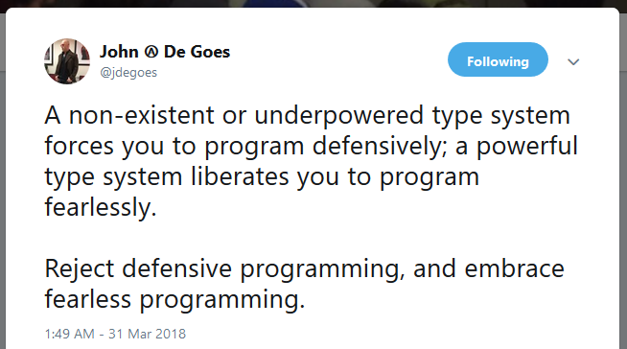

Static typing Program fearlessly
Not in Haskell
“If it compiles, it probably works!” Program correctness tested by the compiler
Notes:
Haskell is a statically typed language. This means it has a type system that is enforced and checked by the compiler at compile time. People still debate static vs. dynamic languages, but one only needs to look at the JavaScript ecosystem to see the value of a statically typed language. People have had to literally make new statically-typed languages that compile to JavaScript, such as TypeScript, in order to be able to manage larger and larger JavaScript codebases. Dynamic typing is fine for small scripts, throw-away prototypes and for quick coding, but for quality non-trivial software, developers need static types to help them manage complexity.
John De Goes has commented on Twitter that an underpowered type system forces one to program defensively. Anyone who has used a type system like C# and Java’s will know this feeling. Having to do null checks and type tests is busywork, yet is easily forgotten and a source of annoying bugs. On the other hand, a powerful type system liberates the developer to make changes with confidence, knowing that the type system will validate his or her code for correctness. John calls this fearless programming.
Haskell has an extremely powerful and strict type system. As a consequence, Haskell forces you to write code that is correct and rejects code that is not. While this may seem arduous as you write code in comparison to a dynamically typed language, what it means is you spend much much less time debugging errors at runtime. It’s somewhat an in-joke that with Haskell, “if it compiles, it probably works” but I’ve found that to be the case far more often than not.

Slide 9

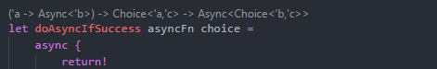
Static typing Type inference
The compiler infers types based on context Take the drudgery out of static typing
printErrorMessage msg =
let err = "Error: " ++ msg
putStrLn err
Inferred to be a String
Return type inferred to be IO ()
A double-edged sword
✘ Inference makes a mess if your code is wrong
✘ Harder to understand code without types
IDE shows the inferred
type
F#
Notes:
One of the annoyances of static typing can be constantly having to tell the compiler what the type of things are as you write code. Thankfully, Haskell has a very powerful type inference engine that can infer the type of your values and functions by looking at the context of what you’ve written. Up on the slide we have a function called printErrorMessage that takes a msg parameter and prints to the console. The msg parameter and err value have both been inferred to be strings. This is because the compiler can figure out they need to be that type because they are passed to the string concatenation function (the ++ operator) and the putStrLn function, which takes a string. The printErrorMessage function itself is inferred to return IO of unit because that’s what putStrLn returns.
However, type inference is a double edged sword. If your code is not correct when you write it, the compiler may infer incorrect types for things, which can make the compiler error messages much harder to understand because it’ll be telling you about types that you didn’t intend to use. It’s also much harder to understand code without the types. Good naming of variables can carry you for a while, but nothing beats a good type to describe exactly what something is. Other languages like F# will try to resolve this issue through tooling. The VSCode extension Ionide will display type signatures for functions to help you understand the code you’re reading. However, this doesn’t help you when you’re reviewing code in another editor, or on GitHub in a PR for example.

Slide 10

Static typing Type inference
Explicit types where helpful Blunt an edge of the double-edged sword
Explicit type signature for top level functions
printErrorMessage :: String -> IO ()
printErrorMessage msg =
let err = "Error: " ++ msg
putStrLn err
Inference used for everything else
Types often describe what a function does Self documenting and enforce correct use
zip :: [a] -> [b] -> [(a, b)]
Notes:
Haskell solves these issues by allowing people to explicitly add type signatures to functions. This helps resolve the issue of when you’re writing code and you’ve got it a little wrong and type inference is messing up your error messages by choosing incorrect types. You start writing a function by defining its desired type signature, then as you write the function, the compiler can fill in the blanks by using type inference. This actually changes the way you write code, whereby you let the compiler guide you by looking at its error messages to determine what you need to do next in your function to satisfy the type signature you started with.
By having the type signature actually in the code, it also means you can view the code directly on GitHub or in any editor you like and still be able to see the type signatures. For me, after having this, going back to read F# code is more difficult because I can’t see the type of functions when I view code on GitHub. In Haskell, the type signatures are just there for me to read.
The type signatures also act as documentation for a function. You can very often look at a function and tell what it does and how to use it by simply inspecting the type signature. We can see that the printErrorMessage function does IO because it returns an IO type. Another good example is the function zip. By reading its type signature, we can see that it takes a list of ‘a’s and a list of ‘b’s, and will return a list of ‘a’ and ‘b’ pairs. We can intuit this means that it combines together two lists and produces a single list of the elements paired together. The a and b are generic types, so this function could be used with a list of strings and a list of ints, for example. It would then return a list of string and int pairs.

Slide 11
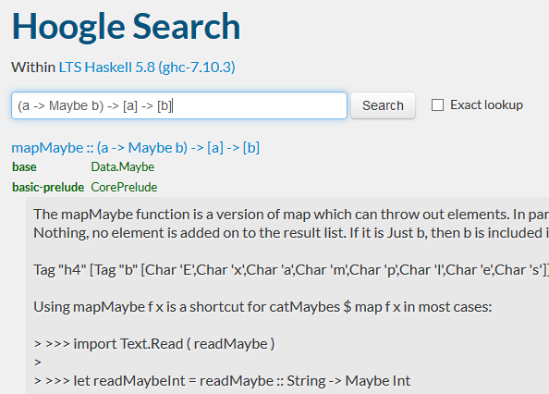

Static Typing
Hoogle Find a function by type
Function that transforms each item in a list and
only keeps some of them
(a -> Maybe b) -> [a] -> [b]
Notes:
This descriptiveness that the type system provides gives unexpected benefits. The Haskell ecosystem has a search engine called Hoogle which allows you to search for functions by their type signatures. Let’s try an example.
Imagine we want a function that takes a list and transforms each element and also filters the list at the same time. F# people might recognise this as the “choose” function, but if we’re new to Haskell, we might not know what it’s called in Haskell. Enter Hoogle! We can write out the type signature for the function. The first parameter is a function that transforms each element a to b, and optionally can discard them, which the Maybe type represents (Maybe we’ll keep the element or not). The second parameter is the input list of “a”s, and the return type is a list of transformed “b”s.
When we put this into Hoogle, it immediately returns a set of matching functions and right at the top is the one we want: the mapMaybe function from the Data.Maybe module. That’s pretty cool!
Hoogle is incredibly useful to see whether there’s a function out there that does what you need, rather than you implementing it yourself. A lot of the time, you’ll be able to pull in a library that does what you want. It’s also super useful when you’re learning and you don’t know where all the basic functions are. You can just ask Hoogle, “I need a function that does ‘this’”, and it gives you a list of matching functions.

Slide 12
Sum types Expressing alternatives statically
data Maybe a = Just a | Nothing
data PathValidationError = ExceedsMaxLength Int | UsesInvalidChars [Char]
| Empty
case maybeVal of Just x -> x + 1 Nothing -> 0
parseFilePath ::
String
-> Either PathValidationError FilePath
data Either a b = Left a | Right b
void ValidateFilePath(string path)
Either Error Int
Notes:
Another static typing feature that Haskell offers to help you write correct and understandable code is something called sum types. A sum type is a type that expresses a fixed set of alternatives. Another way of saying that is that a sum type allows you to define a choice between different things.
A typical example is modelling the presence or absence of a value. Haskell does this with the Maybe type, which can either be Just with the value or Nothing. The syntax up on the slide is saying we have a data type called Maybe, it has a generic parameter we’re calling ‘a’, and it can either be value called Just that contains a value of whatever type ‘a’ is, or it can be a value called Nothing. When we have a Maybe value, we can use Haskell’s pattern matching syntax, which is that case .. of syntax to see whether the Maybe we have is either Just or Nothing and do something different in each case. The Maybe type is built into the Haskell base libraries.
The Either sum type is also built in, and it offers you the ability to model a choice between two different values. We can either be Left which can contain whatever type ‘a’ is, or Right which can contain whatever type ‘b’ is. The Either sum type is often used to model error handling. So for example, Either Error Int is a type that could either be an Left with an Error or Right with an Int.
You can define your own sum types to model alternatives in your domain accurately. For example, we could make an error type that models the different errors we could get when validating a file path. It could exceed the max length of a path, it could use invalid characters, or it could be an empty string. You could then write a parseFilePath function that takes a string, and validates it, returning either a PathValidationError, or a valid FilePath.
A typical way of writing this code in a language like C# would be to use exceptions. We’ve probably all seen a method like ValidateFilePath that you pass a string to and that throws an exception with the error in a string. Unfortunately, we have no way of knowing what sort of errors to expect from ValidateFilePath without reading its implementation. The type signature does not mention the exception that would be thrown.
So we can see how sum types can be used to make error handling explicit, and indeed can be used to make any alternatives in your code explicit in the types. This is also useful when changing code; if you add an alternative to a sum type, the compiler will tell you all the places you need to update to account for the new alternative with compiler warnings. This is a great example of how Haskell helps you refactor your code safely.

Slide 13
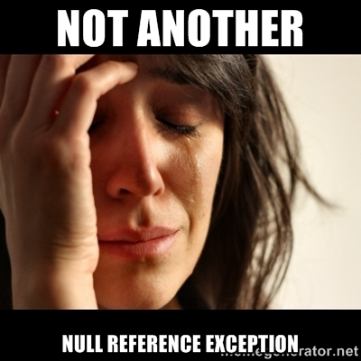
Sum types Eliminating NullReferenceExceptions
data Maybe a = Just a | Nothing
case maybeVal of Just x -> x + 1 Nothing -> 0
find :: (a -> Bool) -> [a] -> Maybe a
public T Find (Predicate<T> match)
Notes:
In fact, through the use of sum types, Haskell eliminates the annoying null reference exception that we get in languages like C# and JavaScript. In C# any reference type can be null. In Haskell, null is not a thing; it doesn’t exist. If you need to model the potential absence of something, you use the Maybe type. This means that in Haskell, you opt-in to “nullability”. If you try to pass a Maybe value to a function that doesn’t take Maybe, then you get a compile error. If a function returns a Maybe and you don’t deal with it, you get a compile error.
This contrasts against languages like C# where you have to opt-out of nullability by doing busy-work and error prone coding, such as checking for unexpected nulls and throwing exceptions. The compiler doesn’t stop you from passing null when you shouldn’t and you find out at runtime with a crash. If you call a function and receive a null and don’t code for it, you get a crash.
Have a look at the Haskell and C# List Find type signatures on the slide. In the Haskell Find, it is impossible to pass Maybes to that function, and you explicitly get back a Maybe to represent if you weren’t able to find that particular element in the list. You can’t get at the contents of the Maybe unless you do a pattern match with case … of like is up on the slide.
In the C# version, you can pass null for that Predicate and get an ArgumentNullException at runtime. You can also get back null from this function, and unless you explicitly check for null being returned, you could get a NullReferenceException.
This is just one of the many ways that Haskell uses its strict and powerful static type system to ensure that you are writing correct and bug free code. By making such concepts explicit in the types, developers can clearly understand the implications and the edge cases of using functions, which means they can write and refactor code more safely and confidently.

Slide 14

Newtypes Cost-free wrapper types
newtype EmailAddress = EmailAddress String
parseEmailAddress ::
String
-> Either ValidationError EmailAddress
sendEmail ::
EmailAddress -> Subject -> Body -> IO ()
sendEmail ::
String -> String -> String -> IO ()
Notes:
Another powerful feature of the Haskell static type system is the ability to define newtypes. A newtype is a data type that simply wraps an existing type. This is useful when you want to add new meaning to an existing type. A good example is an EmailAddress. An email address is a string, but it’s not any string, it’s one that must match a certain format. So you can define a new type called EmailAddress that wraps a string and you then can pass around EmailAddresses instead.
This means you can write validation functions that take normal strings and check that they’re valid email addresses and return either an error or a valid wrapped EmailAddress. The parseEmailAddress type signature on the slide is an example of that. Once you’ve got a valid wrapped EmailAddress, you can pass it around and use it safely in all subsequent code. The compiler prevents you from passing a String to a function that takes an EmailAddress, because an EmailAddress is not the same type as a String. Code that takes an EmailAddress can know that it doesn’t need to deal with invalid email addresses, which simplifies code and helps eliminate bugs.
It also makes your type signatures far more descriptive, which helps the understandability of the code. Have a look at the sendEmail type signature. We can see that it takes an EmailAddress, a Subject and a Body just from the types. If that was just String String String, that’d be far less useful. We can’t accidentally pass the Body where the subject would go; that would be a compile error since Subject and Body are two different types.
The best thing about newtypes in Haskell is that they are cost free at runtime. The compiler, after type checking, substitutes the unwrapped type so that there are no extra memory allocations needed for the wrapper type. This is unlike in other languages where writing a wrapper type has a runtime performance and memory penalty.

Slide 15

Newtypes Cost-free wrapper types
public class Response<T> {
public T Data { get; set; }
public string Error { get; set; }
}
public class JsonString {
public string Value { get; set; }
}
✘ Incurs extra memory allocation
✘ Value could be null (sigh)
✘ Cannot be compared for string equality
public Response<string> GetDevices()
public Response<string> GetDeviceSerial(
string deviceId)
newtype JsonString = JsonString String deriving Eq newtype DeviceId = DeviceId String deriving Eq
newtype DeviceSerial = DeviceSerial String deriving Eq
getDevices :: IO (Either Error JsonString)
getDeviceSerial :: DeviceId -> IO (Either Error DeviceSerial)
Notes:
Here’s a practical example of where newtypes can improve code clarity. On a gig recently I saw some code in a class that talked to an API that deals with some IoT devices. The developer who wrote the code made an Response of T class to represent either some data returned by the API call or an error string if an error happened. He then had methods that called that API. I’ve put the type signature of methods up on the slide. One was called GetDevices and it returned a Response of String. Turns out that String was actually the entire JSON body of the HTTP response. Then he had a GetDeviceSerial which got the serial number of the device with a particular ID, which also returned a Response of String, except in this case the String was a serial number.
Straight away we can see issues here. Both methods return the same thing, but it’s not really the same thing and it’s hard to tell what they actually return without looking at the method implementation. The Response type also doesn’t stop you from having a null Data or Error, or even both Data or Error being set at the same time. In C#, to create wrapper type around those strings to distinguish between a JsonString and a DeviceSerial, you need to create a new class. But this is ugly because it incurs extra memory allocations, the Value could still be null, and you can’t compare that type for equality like you can the string. You can fix all those issues, but it requires lines and lines of tedious and error prone code.
In Haskell, this is a non-issue. We simply create cost-free newtype wrappers for all the Strings and use the Either type to model the alternative between a success and a failure. We could even create a sum type for the Error to explicitly describe the set of errors rather than using a string. Straight away, it’s now clear what our functions take and what they return. Again Haskell is helping us write understandable and correct code through its strict and expressive static type system.

Slide 16
Immutability Removing the moving parts of our code: variables
listB
listA
2
1
●
data Book =
Book
{ title :: String
, author :: String }
changeTitle :: String -> Book -> Book changeTitle newTitle oldBook = oldBook { title = newTitle }
Notes:
Variables are moving parts in our code and we know that undisciplined use of variables can result in code that is very difficult to reason about and therefore get correct and bug free and maintain into the future. Working with immutable data structures simplifies code by removing those moving parts: the variables.
It’s not that immutable data structures don’t change, it’s that they operate on a copy-on-write basis. “Modifying” an immutable data structure results in a new copy being created with the modifications. This isn’t as inefficient as it sounds as many data structures reuse a large part of the old data structure in their new version. For example, a Haskell list is a singly-linked list, so adding a new element to a list simply means adding a new node to the front of the existing data structure. As you can see up on the slide, listA is still unchanged, but the new listB reuses listA’s nodes inside itself.
All data types in Haskell are immutable. It is not possible to create mutable data types in Haskell at all. This guarantee takes a lot of complexity and unknowns out of your code immediately. You never to need to wonder whether a type might be mutable and therefore whether you need to worry about it being mutated unexpectedly. If I pass a data structure to a function, it is 100% guaranteed that that function cannot mess with it. If you pass a list to a method in C#, for example, you don’t get a guarantee that method isn’t going to modify the list or the list contents. In Haskell, as a function author, I know if I am passed something, I can safely use it without worrying that something else that I don’t know about, perhaps on another thread, might change it. I don’t have to check that assumption; in Haskell, it is a guarantee.
Haskell has languages features that make it very easy to work with immutable data structures. Up on the slide I have defined a Haskell record type called Book that has title and author fields. We then define a function called changeTitle that takes a new title and an old book, and creates a new book based on the old book with the new title. Haskell takes care of copying the other fields on the record such as author for us. This is in stark contrast to languages like C#, where creating and working with immutable data structures is extremely tedious. You’d need to make a class with read only properties, a constructor that takes all values and sets the properties, and methods that manually do copy on write. It’s so painful, it’s not surprising nobody does it.

Slide 17

Pure functions No side effects, less complexity
map :: (a -> b) -> [a] -> [b]
type Book() =
member val Title = "" with get,set
member val Author = "" with get,set
let changeTitle (newTitle : String) (oldBook : Book) : Book =
oldBook.Title <- newTitle
oldBook
Notes:
Functions take input and return output. A pure function is one that has no side effects and that when given the same input, produces the same output. Impure functions are hard to maintain and reason about because they depend on shared state, so in order to think about what they do you have to expand your mind to encompass every other piece of code that shares that state as well as the impure function at hand.
Pure functions can be viewed and understood entirely in isolation. Their type signatures give a very strong signal as to what they do, which really helps maintainability. You often don’t need to dive into the implementation of a function to know what it does, you can just look at the types since there’s no fear that it’s doing some invisible side effects that you need to know about.
If we look at the map function type signature on the slide, we can very clearly see what the function does. You give it a function that converts as to bs, and you also give it a list of as, and it gives you back a list of bs.
The ‘a’ and ‘b’ here are abstract, like generics in C# or Java. There is no type-casting in Haskell, so when a function receives an abstract type like ‘a’ or ‘b’, it literally can do nothing with it because it doesn’t know what it is. In this case, the map function can do nothing with ‘a’ or ‘b’, except for converting an ‘a’ into a ‘b’ because it was given a function that can do that. So as someone looking at this function, you know that there cannot be any black magic going on inside this function that could bite you. Because all data types are immutable in Haskell, you know that the list it produces is a new list, and the original list is untouched. You don’t need to check the documentation or the implementation to know this.
This strictness gives you confidence as a developer to know what a function can do without checking its implementation for unexpected behaviour. It means you can write and refactor code with confidence.
This is in contrast to other less strict FP languages, like F#. If I see a function in F#, there is no guarantee that the function doesn’t modify some static variable, or mutate its input parameters, or perform any other side-effect. It’s good practice in F# to not do that and to work with immutable types. But because mutability and impurity is allowed, you don’t have an absolute guarantee. You lose a level of trust and have to spend more time checking assumptions. For example, look at the F# changeTitle function up on the slide. I can see that it takes a newTitle and an old book and returns a Book. But unless I check if Book is an immutable type, I have no guarantee that that function is pure. For example, Book might be a mutable class type and changeTitle might be mutating the input Book and returning it. That would be poor form in F#, but is possible.
In Haskell, it is impossible because mutability does not exist. So Haskell’s restrictions of requiring immutability and purity actually benefit the developer by ensuring that he or she can make safe assumptions about how code works.

Slide 18

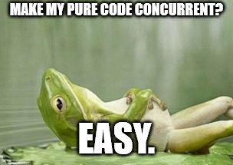
Immutability and pure functions Testability and concurrency
Naturally testable Reproducible results: same input, same output
Concurrency-safe Immutability and purity eliminates race conditions
Notes:
Immutability and pure functions also aid us in writing testable code. Pure functions are naturally testable because they don’t have side effects. If you give a pure function the same input, it will always deterministically return the same output, which makes it super easy to test! Just pass your input and assert that it returns what you expect. Simple! As a contrast, impure code that has side-effects either can’t be tested, or must have those side-effects mocked out or carefully managed, resulting in complex and fragile tests.
Pure code is also very easy to make concurrent. The biggest issue with writing concurrent code is dealing with race conditions where two threads modify shared state in unexpected ways and at unexpected times. Because pure code only works with immutable data types, it is impossible for multiple threads to interfere with each other since mutable state does not exist. Haskell’s purity guarantee means that you can trust that any pure functions are safe to use in concurrent parts of your application. They can’t modify any shared state by definition, which means you know for sure that whole classes of race conditions are just not possible.
Again this is another Haskell guarantee that gives you confidence that you are writing correct code.

Slide 19
Purity in an impure world Managing impurity in Haskell
getCurrentTime :: () -> UTCTime
Impossible in Haskell
getCurrentTime :: IO UTCTime
getCurrentTime :: () -> IO UTCTime
This function is still pure
currentPlus10Seconds :: IO UTCTime currentPlus10Seconds = getCurrentTime >>= \currentTime -> pure $ seconds 10 `addUTCTime` currentTime
Lambda function
Bind: function on the right is called with the value “inside” IO
main :: IO () main = currentPlus10Seconds >>= print
Prints to the console
Notes:
Purity is all well and good, but your program is useless unless it can actually do some side effects and affect the real world. So if Haskell’s so pure, how do we manage impurity? A function for getting the current time is a good simple example. On the slide is a function that takes unit (eg void) and returns the current time. However, this function is impossible in Haskell since for that function to return a different UTCTime each time it is called with the same input value (unit), it would have to violate purity.
This is where Haskell’s IO monad comes in. The IO monad allows us to write impure code in a pure way. So our getCurrentTime function would look like this instead; it would return an IO of UTCTime. In fact, because of purity, that function would always have to return the same value anyway, so we can drop the input parameter and just have a value instead of a function, and that value is of type IO of UTCTime.
So how can we use this? Well, let’s write something that calculates the current time plus 10 seconds. To do this, we can use the “bind” operator, which allows us to hook a function up to receive the value “inside” the IO. Here’s we’re using a lambda function that will take the current time value and add 10 seconds to it. This lambda function itself is still pure code. Given the same time, it’ll still return the same value. The IO type in the signature is a big signal to the developer that there’s impure stuff going on in this code, which is a bonus for the code readability.
IO values are just potential values; to actually run them and see them do IO, we need to hook them up to the real world. We can do this by hooking them up the program’s main entry point. In this case up on the slide, we’ve got a little program that reads the current time, adds 10 seconds to it, and then prints that to the console and quits.

Slide 20
Purity in an impure world Managing impurity in Haskell
IO
Purity
plus10Seconds :: UTCTime -> UTCTime plus10Seconds currentTime =
seconds 10 `addUTCTime` currentTime
currentPlus10Seconds :: IO UTCTime currentPlus10Seconds = getCurrentTime >>= plus10Seconds
Notes:
So we can now affect the real world by using the IO monad. However, this doesn’t mean we want to do our entire program inside IO. What we want to achieve is the majority of our code to be written outside of IO in a pure fashion, and then we connect its edges up to the real world with a little IO. In other words we want to push our IO to the edges of our application. This makes our code a lot easier to test and reason about.
Here’s a micro example of how we could cut our previous code up in order to keep the IO bits separate from the actual program logic. Notice how we’ve pulled our pure lambda out into a separate function. We can test and reason about that easily now.
Seeing the IO type on functions and values is an instant indication that some sort of side effects are going on in that code. This makes the division between impure and pure code very obvious and not a nasty surprise to the developer. This is important when writing new code or refactoring existing code, because you can immediately start thinking about the additional complexities that side-effectful code introduces and be wary. On the flip-side, not seeing IO means you don’t need to think about those complexities at all.

Slide 21

Value semantics A boon for testability
data Transaction =
Transaction
{ date :: UTCTime
, amount :: Decimal }
deriving Eq
Automatically adds the ability to do value equality
it "returns the expected list of transactions" $ do
let invoice = ...
let actualTransactions = getTransactionsForInvoice invoice
let expectedTransactions =
[ Transaction date1 amount1
, Transaction date2 amount2 ]
actualTransactions `shouldBe` expectedTransactions
shouldBe simply does an equals of the two lists
Notes:
Haskell makes it very easy to get value semantics for your data types. Value semantics is where the identity of an object is determined by its value, rather than the particular instance of the object. For example, ints and strings in C# have value semantics, but by default classes have reference equality. When types are mutable, value semantics can be tricky since equality results change when the instance mutates. But since everything in Haskell is immutable, it’s very easy to start using value semantics. In fact, usually all you need to do is ask the compiler to derive the Eq typeclass on your type.
Have you ever tried to write a test where you need to compare list of objects, or nested object graphs? It’s super painful without value semantics. You need to compare each list element individually in a loop, and compare each property individually. Wouldn’t it be better if you could just construct the expected result and just go “equals”!
Well, in Haskell, you can. So we could write a unit test that gets a list of transactions and simply does a comparison of the expected list and the actual list using equals. That’s all the `shouldBe` assertion does internally. Lists in Haskell are also equatable, so long as what they contain is equatable, and in this case our Transaction data type is, so our lists are too.
Compare how easy this was to achieve versus how you’d need to do in C#, for example. In C#, you’d need to manually implement Equals for your type, comparing each property by hand. And if you add a new property later, you’d better remember to update your equals implementation, or you’ve got a bug. In Haskell, the compiler takes care of it for you, ensuring that you can easily modify your code with confidence in the future.

Slide 22

Property testing
prop "reversing a list twice returns the original list" $ \list -> list === reverse (reverse list)
Lambda function
Generated list passed as this parameter
prop "all invoices must generate at least two transactions" $ \invoice -> do let actualTransactions = getTransactionsForInvoice invoice length actualTransactions `shouldSatisfy` (>= 2)
Notes:
Property testing is another thing that is very easy to do in Haskell, especially with value semantics being easily doable. Property testing is where you can have your test framework generate random input values and you write a test to check that your code works in a certain way for all generated input values. In other words, for all inputs, a certain property holds for your code under test.
The textbook example of this is if you were writing tests for a list reversing function. A property of reversing a list is that if you reverse a list twice, you get back the original list. This property holds no matter what list you do the double reversal on. So you can see in the code up on the slide, we are passing a lambda function to the property test. The test framework will call our lambda function passing in empty lists, lists with one thing in them, two things in them, 10 things in them, etc. And we assert that our input list is the same as reversing the list twice. If any input causes that assertion to fail, our property test fails.
Properties are particular to your domain. So imagine in our domain we could say that all invoices must generate at least two transactions. We could write a property test that generates random invoices, and checks that our transactions list length is always greater than or equal to 2.
Property testing is a great way to ensure that you are writing correct code that stays correct as you change it over time.

Slide 23

Laziness
fromMaybe :: a -> Maybe a -> a
ghci> fromMaybe "Fallback" (Just "Something")
"Something"
ghci> fromMaybe "Fallback" Nothing
"Fallback"
Not evaluated unless actually used
let expensiveValue = primes 1000000 in fromMaybe expensiveValue maybeANumber
Notes:
Haskell is a lazy language, as opposed to the traditionally strict languages we normally use. This means you can write code in what appears to be an inefficient way from a strict language point of view, but since Haskell only evaluates what is necessary when it is actually needed, your code executes efficiently.
Laziness helps you subtly all over the place when writing Haskell. To demonstrate laziness on the slide we’re going to use the fromMaybe function. Let’s see how that function works. fromMaybe takes a Maybe value and a fallback value and returns Maybe value if it exists, or the fallback value is the Maybe is Nothing. So the examples on the slide show that when Just Something is provided, fromMaybe returns Something, but when Nothing is provided, the Fallback value is returned.
Now let’s see how laziness kicks in by looking at the code at the bottom of the slide. In a strict language, that expensiveValue would be evaluated before being passed to fromMaybe. So you’d pay the cost of calculating that fallback value even if it wasn’t going to be used. In Haskell, expressions are only evaluated when their value is required, so the millionth prime would only be calculated if the Maybe was Nothing. If the maybe was Just, we don’t need that fallback value and so it wouldn’t be calculated.

Slide 24
Laziness
fmap (transform each item in the list)
notSoExpensiveList =
let transformedList = expensiveTransform <$> bigList in take 5
. drop 100
$ transformedList
Read from bottom to top
Notes:
Here’s another example. Imagine we’re transforming each item in a big list with some expensive calculation. However, we only want the 101-105th elements from the list. In a strict language, we’d be paying the expensive transform cost for at least the first 100 list elements that we’re dropping before getting the 5 that we actually want. However, in Haskell, laziness ensures that the transform is done only when required and so when we eventually look at those 5 elements we’ve picked out of the list, the transform will be done then on those 5 elements only.
Laziness means you can write code more declaratively in a way that reads more cleanly, and only the parts that are needed are actually run.

Slide 25
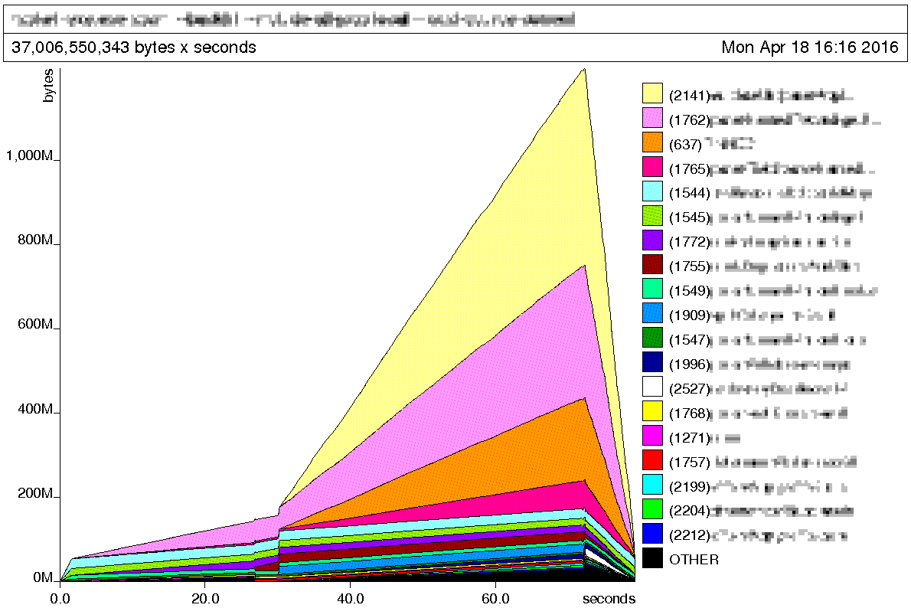

Space Leaks
data Job = Job
{ jobId :: JobId
, advertiserId :: AdvertiserId
, location :: Location }
loadJobs :: FilePath
-> Map JobId Job
Notes:
However, laziness is a double edged sword. You gain execution efficiencies, but you can also get cut by a new type of memory leak: space leaks. This is where, because of laziness, you may retain things in memory longer than you expect because the code that would otherwise decide to drop that memory hasn’t actually run yet.
On a past Haskell project that I worked on, we had an issue where we loaded a lot of jobs from a CSV data source and put them in a map. Each CSV row contained far more information than we actually needed, so we only stored a few small columns in our record, which you can see on the slide. However, our program used a lot of memory for no apparent reason, even though we were keeping only a few fields from each row. You can see the chart the Haskell memory profiler generated for us on the slide.
What was happening was that each CSV row was being read in for parsing. However, when we set the properties on our records (such as jobId), the actual parsing of the row in memory to get our couple of fields was lazy. So until we actually needed the values of the properties on Job (assigning them doesn’t count), parsing wasn’t done and so the memory holding what needed to be parsed was kept around. So the whole CSV was effectively kept in memory.

Slide 26
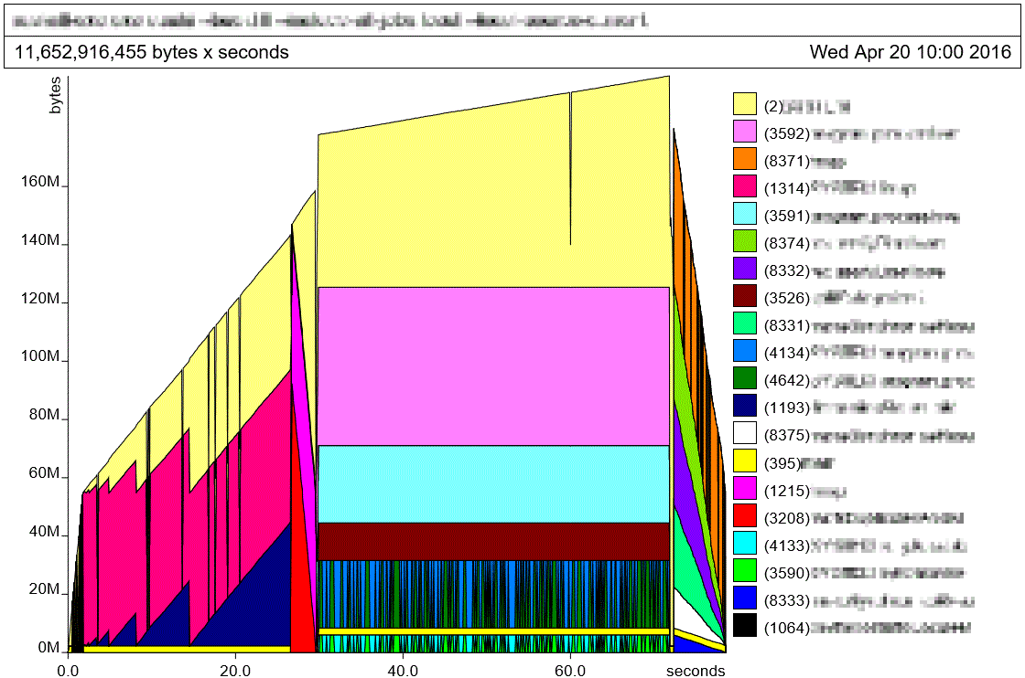


Space Leaks
data Job = Job
{ jobId :: JobId
, advertiserId :: AdvertiserId
, location :: Location }
loadJobs :: FilePath
-> Map JobId Job
Notes:
We fixed this by forcing strictness on each Job as we created it, which forced the evaluation of the parsing logic, which now complete, dropped the CSV row from memory. As you can see, we went from over a gigabyte in memory usage, down to around 180MB.
In my mind, this is the biggest downside of Haskell. Laziness, while often useful, also sometimes makes it hard to reason about the execution time and memory usage of code, so you need to keep an eye on it so you aren’t in for any surprises when you’re dealing with a large dataset or high load. However, I think it’s fair to say that for any application that will experience high load you should always be testing it under that load, so that requirement isn’t an unusual burden.

Slide 27
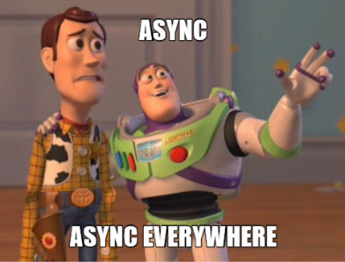
Asynchrony and concurrency
readFromWebServices :: IO ()
readFromWebServices = do
responseA <- getWebResponse "A"
responseB <- getWebResponse "B"
putStrLn ("A: " ++ responseA ++ " B: " ++ responseB)
readFromWebServicesInParallel :: IO ()
readFromWebServicesInParallel = do
(responseA, responseB) <- concurrently
(getWebResponse "A")
(getWebResponse "B")
putStrLn ("A: " ++ responseA ++ " B: " ++ responseB)
Notes:
Developers are excited about various languages and runtimes that allow them to do asynchronous and concurrent programming more easily. Traditionally threading and concurrency has been quite difficult to manage by hand, so C#’s async await, NodeJS’s non-blocking IO, and Golang’s lightweight goroutines get developers salivating.
Haskell also has very elegant and powerful handling of asynchrony and concurrency. Haskell’s runtime uses a lightweight threading model which means you can spawn many many threads with very little overhead. All IO operations are non-blocking by default, in that they don’t block an OS thread. This means that Haskell is “asynchronous” by default. However, Haskell gives you explicit control over when you go “concurrent” and when you don’t.
For example, the readFromWebServices function on the slide is asynchronous in that each getWebResponse call doesn’t block a thread. However, that function doesn’t perform those web requests in parallel. If you want to go parallel, you can ask the Haskell runtime to perform the IO concurrently. That’s what we’re doing in the readFromWebServicesInParallel function. The simple change is to pass each IO operation (getWebResponse A and getWebResponse B) to the concurrently function. Haskell’s libraries offer many functions that make doing things concurrently simple, such as functions that will run a list of IO operations in parallel and so on.
Though Haskell can expose the underlying threading model to you, most of the time you work with higher level constructs. This means you usually don’t mess around with threads, instead you just work with concurrency functions in an async/await style of coding and let the runtime figure out how to get the best out of your multiple cores. And of course, since there’s no mutability in Haskell, writing correct concurrent code is much easier.

Slide 28
Higher-kinded types
data DogeEnum = Such | Wow
enum DogeEnum { Such, Wow }
Kind: Type
Kind: Type
data Maybe a = Just a | Nothing
class Maybe<T> { … }
Kind: Type -> Type
Kind: Type -> Type
Maybe Int
Kind: Type
Maybe<int>
Kind: Type
map :: (a -> b) -> f a -> f b
F<B> Map<F<>, A, B> (Func<A, B> f, F<A> x)
Kind: Type
Kind: Type -> Type
Can’t do this in .NET
Notes:
Most statically typed language these days support the concept of generics, or type parameterization. Generic code is extremely useful for expressing abstractions that don’t care about the types used within it. For example a List of T, where T can be any type. Haskell’s type system takes this one step further by supporting a feature called higher-kinded types.
You can think about kinds as a way of expressing types of types. Types without generics are just types. However, when you introduce generics, you change the kind of the type to be a type function: ie a type that takes another type to produce a type. This is why Maybe a has a kind of type arrow type, because it’s a type function that takes a type and returns a type. If you “call” the Maybe type with Int (written as Maybe Int), then you’ve invoked a type function and just made a new type that is Maybe specialised to Ints.
Higher-kinded types is where you can write generics code where the generic type parameters can be “higher kinded”. ie type arrow type, or type arrow type arrow type and so on. We can see in the example up on the slide that the map function is generic over a type called f, whose kind is type arrow type. This isn’t possible in .NET for example, but it is possible in Haskell.

Slide 29
Type classes and higher-kinded types
class Functor f where
map :: (a -> b) -> f a -> f b
instance Functor Maybe where
map fn (Just x) = Just (fn x)
map fn Nothing = Nothing
map intToString (Just 123)
(Int -> String) -> Maybe Int -> Maybe String
instance Functor [] where
...
map intToString [123,124,125]
(Int -> String) -> [Int] -> [String]
instance Functor IO where
...
map intToString (readFromFile "integer.txt")
(Int -> String) -> IO Int -> IO String
intToStringAnyFunctor :: Functor f => f Int -> f String
intToStringAnyFunctor x = map intToString x
Notes:
Typeclasses are another Haskell feature that when used with higher-kinded types allows us to write some extremely powerful abstractions. These abstractions make our code much less noisy and allow for high levels of code reuse. Don’t confuse typeclasses with OO classes; typeclasses are more like traits, if you’ve ever used a language that has traits.
Let’s see one in action. We can define a typeclass called Functor that takes a higher-kinded type f and defines a single function called map. We can then create typeclass instances, which are implementations of that typeclass for concrete types. For example we can create an instance of Functor for the Maybe type. We can then use our map function on Maybes, and Haskell knows to use this concrete typeclass implementation. See on the right hand side of the slide where we’re passing an intToString function to map along with a Maybe to convert the Int that the Maybe contains into a String. If we substitute the concrete types into the map type signature, you can see the a is now Int, b is String and f is Maybe.
We can implement Functor for many more types, for example List and IO, and use map in the same way. You can see in each of these the only thing that is different is that f is List and IO respectively.
This is very powerful because it means we can write a function that works with any functor. So for example, we could make a intToStringAnyFunctor function that works for any functor. We can see in the type signature we’re saying we have an abstract f and that f must be a Functor.
Typeclasses let us write functions that are abstract over types and therefore get good code reusability. It also means when I look at a function like intToStringAnyFunctor I have confidence that the only thing it can do with that f type is use the map function on it. This means I can trust that if I pass it a list, it’s not going to mess with it in an unexpected way. It can only do a list map and nothing else. Again, this clarity and strictness means we can look at a function and be confident about what it can and can’t do, and therefore write and refactor more confidently. There are no surprises or black magic allowed.

Slide 30

Optimised for functional programming
Less non-functional baggage Functional-first
Special garbage collector Optimised to collect a lot of garbage
Functional libraries No compromises
Notes:
The nice thing about programming in Haskell is that Haskell is a functional-first language. Often other functional languages come with the baggage of the non-FP platforms they’re built on. For example, Scala doesn’t support mutually recursive functions because the JVM doesn’t have tail calls. This means that recursion, which is a key functional technique, needs to be handled with care and often worked around with a technique called trampolining. F# doesn’t support higher-kinded types, because .NET’s generics system doesn’t support them. Haskell’s runtime was built with functional programming in mind and doesn’t have either of these two limitations.
Haskell’s runtime includes a special garbage collector that is built to handle the generation and collection of lots of garbage. Because everything’s immutable in Haskell, a lot of intermediate garbage values are created in typical programs. Haskell’s garbage collector can take advantage of the guarantees that function purity provides and uses techniques that ensure that lots of garbage that’s generated then discarded in a short amount of time costs very little to dispose of.
One of the advantages of using F# is that you can lean on the entire of the .NET ecosystem for libraries. The downside of this is that often you’ll be dealing with OO-style libraries that love their mutability, when you’d rather deal with an FP-style library that uses functional types like Option and works in an immutable fashion. In Haskell, all the libraries are functional and immutable, so you don’t have to compromise.

Slide 31
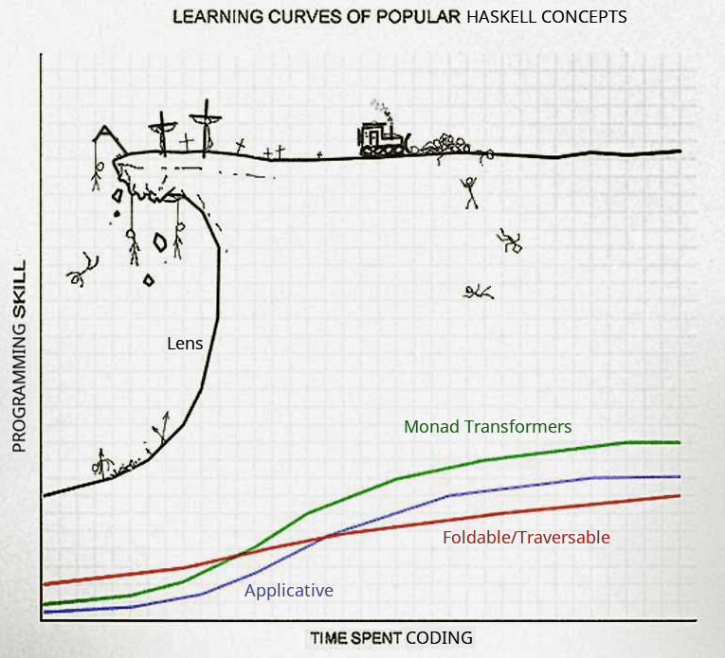
Learning curve Understanding the cray-cray
Steep learning curve Upfront learning required
Real programs require: Functor Applicative Monad (IO, State, Maybe, Either, Reader, Writer)
Monad Transformers
Foldable
Not insurmountable! Does not require a maths background!
Notes:
The learning curve of Haskell is one of it’s disadvantages. Learning a language like F# is easier because it’s a hybrid language with OO, which lets you lean on your previous knowledge as you adopt and get used to the new functional bits. Because Haskell enforces purity and immutability, and is a lazy language, writing real programs in it can be quite different to other languages. This means there’s can be a lot of upfront learning that you need to do to learn how to do things in a pure functional way. However, we shouldn’t be surprised that this is the case, and it’s unfair to compare it in the same way as you might compare a C# developer picking up JavaScript. While C# and JavaScript have their differences, the syntax is still C-based and they’re still both imperative, mutable, strict-evaluation languages. Haskell is much more different, in that it’s not C-based, is functional, immutable and has lazy evaluation; so naturally things are going to be different!
Another perspective on this is that learning functional programming properly is actually easier in Haskell, because the whole language is geared for it and so libraries and examples are always done in a pure functional style. Of course, because pure FP is quite different to imperative programming, it’ll take a bit of learning to adjust, but you’ll come out with a more sound understanding of FP at the end.
Real Haskell programs require you to pick up many different functional concepts, such as Functors, Applicatives, Monad (of which there are many, such as IO, State, Maybe, Either, Reader, Writer), Monad Transformers and Foldable. There’s lots of new things to learn, but all of them are helpful abstractions that soon become as familiar as the strategy pattern is in OO. Don’t try to reach for your OO abstractions; instead think about what problem they’re originally solving and find out how that’s solved using functional techniques instead. For example, in FP dependency injection is just function composition.
It is important to realise that getting over Haskell’s learning curve is absolutely an achievable task. While concepts like monads and functors sound scary, you don’t need to be a genius or a maths guy to understand them. There are plenty of good tutorials online and books to read that explain what they are, how they work and why you’d used them. I’ll recommend a few at the end. These abstractions aren’t just academic and learning them is an investment that pays off, as they allow you to write declarative code that has minimal plumbing and that expresses intention. Haskell is a very deep language; don’t measure your progress by seeing how far you are away from knowing everything; instead focus on whether you know what you need to to solve your problems.

Slide 32

Tooling Stack
Manages dependencies and compilation
Downloads compiler and libraries, builds and tests your code
LTS (Long Term Support) Branches Eliminates dependency hell and global versioning
Cross-platform
Works on Windows/Mac OS/Linux
Notes:
Tooling is one of Haskell’s weaker areas. It doesn’t have the profusion of IDEs, profilers, and other tooling that an ecosystem like .NET or Java has. However, Haskell has got a lot better over the last few years. Managing different versions of the Haskell compiler and library versions used to be painful in the past. Developers who use NodeJS are probably familiar with issues like NodeJS runtime versions, libraries with clashing versions, globally installed libraries and tools clashing between projects.
However, in Haskell-land these sorts of issues have been solved with a tool called Stack. Stack is a relatively new tool in the Haskell ecosystem and it has rocketed to popularity. Stack is a bit like NVM and NPM combined. It downloads the Haskell compiler and the libraries your project needs, and manages building and testing your code.
Stack eliminates versioning and dependency hell by fixing the versions of the compiler and libraries in a branch called an LTS. You tie your Haskell project to a particular LTS version, and Stack automatically acquires the correct version of the compiler, and uses the correct versions of libraries that all work together. The Stack maintainers regularly release new LTSs to include newer library and compiler versions, and they’ve already done the work to make sure everything works together properly. You never need to resolve another version conflict yourself again. You can work on two projects that use two different LTSs and Stack manages the versioning for you transparently.
Stack has also made cross platform development just work. I remember playing with Haskell before Stack existed and getting things to work on Windows was painful, with some packages not even compiling. Now with Stack I don’t have issues. My previous Haskell team had devs on MacOS as well, plus we built and ran on Linux for CI and production, and it just worked.

Slide 33

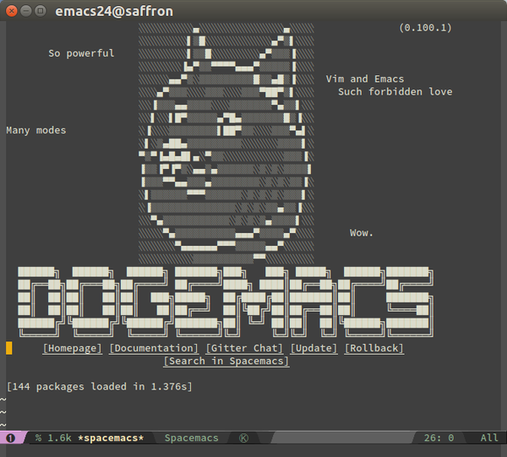

Tooling Editors
Atom IDE-Haskell plugin set + GHC-mod
VSCode Haskell Language Server Client plugin + Haskell IDE Engine
Emacs Haskell layers available: intero or lsp-haskell
Notes:
Haskell may not have a Visual Studio or IntelliJ equivalent, but that doesn’t mean it’s bereft of editors. The IDE-Haskell set of Atom plugins makes Atom a competent Haskell editor. It has syntax highlighting, autocomplete, errors, warnings, linting and hover-over type information. The intelligence behind the autocomplete and type information that these plugins surface is from a Haskell tool called GHC-Mod that the Atom plugins will use behind the scenes. This was the editor that my previous Haskell team had the most success with.
If you’re a VSCode or Emacs fan, there’s editor support for Haskell in both.
Lightweight editors are more popular these days so the lack of an IntelliJ or Visual Studio equivalent is less an issue, as people tend to prefer editors that start and run fast, though they might offer less features. Personally, I’m a fan of tools like ReSharper, so I feel their loss, but the advantages and pleasure of writing code in Haskell for me overcomes the reduced features in tooling.

Slide 34
Tooling Stack and Editors
Stack manages dependencies and compilation
Downloads compiler and libraries, builds and tests your code
Stack LTS (Long Term Support) Branches Eliminates dependency hell and global versioning
Cross-platform
Works on Windows/Mac OS/Linux
Atom
IDE-Haskell plugins
VSCode
Haskell Language Server plugin
Emacs
Intero layer
Notes:
Tooling is one of Haskell’s weaker areas. It doesn’t have the profusion of IDEs, profilers, and other tooling that an ecosystem like .NET or Java has. However, Haskell has got a lot better over the last few years. Managing different versions of the Haskell compiler and library versions used to be painful in the past. Developers who use NodeJS are probably familiar with issues like NodeJS runtime versions, libraries with clashing versions, globally installed libraries and tools clashing between projects.
However, in Haskell-land these sorts of issues have been solved with a tool called Stack. Stack is a relatively new tool in the Haskell ecosystem and it has rocketed to popularity. Stack is a bit like NVM and NPM combined. It downloads the Haskell compiler and the libraries your project needs, and manages building and testing your code.
Stack eliminates versioning and dependency hell by fixing the versions of the compiler and libraries in a branch called an LTS. You tie your Haskell project to a particular LTS version, and Stack automatically acquires the correct version of the compiler, and uses the correct versions of libraries that all work together. The Stack maintainers regularly release new LTSs to include newer library and compiler versions, and they’ve already done the work to make sure everything works together properly. You never need to resolve another version conflict yourself again. You can work on two projects that use two different LTSs and Stack manages the versioning for you transparently.
Stack has also made cross platform development just work. I remember playing with Haskell before Stack existed and getting things to work on Windows was painful, with some packages not even compiling. Now with Stack I don’t have issues. My previous Haskell team had devs on MacOS as well, plus we built and ran on Linux for CI and production, and it just worked.
As for editors, my previous team had the most success using Atom and the IDE-Haskell plugins, but support exists in VSCode and Emacs as well.

Slide 35

Haskell or the Highway? Consider Haskell if…
You’ve done some FP before You enjoy FP, and get frustrated with the OO-bits of
your FP-hybrid language
You ❤ purity & immutability You’ve seen how useful these are and want more
You’re willing to learn new things Haskell is very different, but is rewarding and absolutely
within reach
You need correctness and clarity Correctness and clarity of code are paramount to you
Notes:
So am I saying that if you want to do functional programming, you should use always use Haskell if you want to be a real functional programmer? No! I would never say that Haskell should be used in all situations, and I’d never say that about any specific technology. Unfortunately, the world is not black and white and your personal requirements may be different. If you don’t feel ready to go whole hog on functional programming, purity & immutability and would like to stay in familiar .NET or Java-land, both F# and Scala are competent languages and I encourage you to use them.
With that said, I think you should consider Haskell if you’ve done some FP before in a hybrid language and you’re loving it, but are getting frustrated when you have to cross over into the mutable OO part of the language.
If you’ve seen how useful purity and immutability are and want more, then Haskell might make you very happy.
Haskell is quite different, but if you’re willing to learn new things, then it is extremely rewarding and absolutely within reach for those who have the patience to learn.
If correctness and clarity are of paramount importance to you, then Haskell is a good choice, as you can express intention in a clear declarative style.

Slide 36
Haskell or the Highway? What’s Haskell good for?
✓
Data parsing and processing Haskell’s declarative style and parsing libraries
make this a pleasure
∼
SQL Databases PostgreSQL is popular, but MSSQL or Oracle is not
✓
Complex algorithms Easy to construct DSLs to make code understandable
✗
GUI Desktop Applications GTK libraries exist, but forget about WPF/XAML
✓
Web Services Haskell has great libraries for creating and consuming
web services and dealing with HTTP and JSON
State of Haskell Ecosystem bit.ly/haskell-sotu (h/t @GabrielG439)
✓
Scripting and Command-Line Statically-typed but with powerful type inference and
first-class command-line argument parser libraries
Notes:
So what sort of applications are good in Haskell? Well, any time you’re wanting to do some data parsing and processing, Haskell’s a great choice. Its declarative style and great parsing libraries make that sort of problem a pleasure to solve.
Any program with complex algorithms is going to be great to write in Haskell as you can easily write DSLs to make the code understandable and the type system and stellar testing capabilities make ensuring correctness easy.
Programs that consume web services or are web services are well supported in Haskell. There are great libraries available for dealing with HTTP and JSON.
Scripts and command-line programs are great to write in Haskell. Scripts can often grow out of control, but Haskell’s static typing and its type inference helps keep your scripts correct but still concise. Haskell also has the best command line argument parser library I’ve ever used.
However, Haskell is not suited for everything (yet). SQL Databases are a surprising weak point. If you’re wanting to use PostgresSQL, you’ll be fine, but major databases like SQL Server and Oracle have some support but apparently it’s not perfect.
GUI desktop applications are also not Haskell’s forte. There are libraries that help you write GTK apps, but forget about WPF and XAML.
The “State of the Haskell Ecosystem” document that Gabriel Gonzales keeps up to date on GitHub is a good place to look to see whether your particular problem is well suited to Haskell.

Slide 37





Who else is using Haskell?
Notes:
So who else in industry uses Haskell in production? The highest profile use I know of is at Facebook’s where they use Haskell to fight spam. They developed the Haxl data access framework that allows them to quickly and efficiently access the data they need to figure out whether posts are spam. Facebook have done a number of presentations about this, which you’ll be able to find recordings of if you Google for it.
SEEK has a couple of teams that work in Haskell to do data processing and analysis as well as internal APIs; it was at SEEK that I got my production Haskell experience and developed my love of the language.
Helium is an IoT startup that offers a range of sensors that report data into the cloud for analysis. They use Haskell on the server side; Reid Draper did a talk on their use of Haskell at YOW 2015 that you can find on YouTube.
CircuitHub is a company that wants to be the AWS of manufacturing and their software lets you get instant quotes on parts, PCBs and assembly and then get your product manufactured. Their core services and algorithms are written in Haskell.

Slide 38
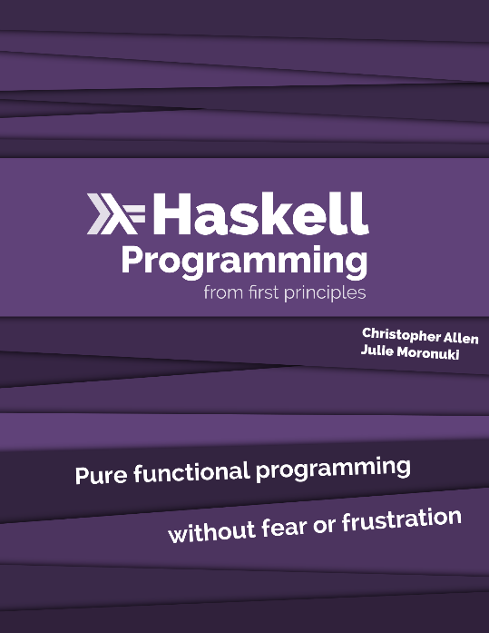


Learning Resources
Maybe Haskell Small book with pragmatic examples of why you should care about FP and Haskell
/r/haskell Good place to see what’s going on in the community and ask questions
FPComplete Blog Haskell-tagged posts contain some great practical advice
haskellbook.com
learnyouahaskell.com
Notes:
If you want to learn Haskell, I highly recommend the Haskell Programming from First Principles book. It starts from the beginning, goes into sufficient detail and doesn’t gloss over things, and has exercises that you can do if you want to cement concepts in your head.
Learn You a Haskell for Great Good is book you can read for free online, so if you’re looking for a free alternative, that’s a good one to look at. However, it does contain some mathsy bits, which can be a little confusing to those unfamiliar.
Maybe Haskell is a small book that has some pragmatic examples of why you should care about FP and Haskell. The Haskell subreddit is a good place to ask questions and see what’s going on in the community. Obviously Stack Overflow is good too. The Haskell-tagged posts on the FPComplete blog contain some good practical advice for writing production Haskell too.

Slide 39

Conclusion
Strong static typing
Refactor fearlessly
Type inference
Hoogle function search engine
Testability
Value semantics
Property testing
Tooling
Easy dependency management Atom/VSCode/Emacs
Sum types
Model alternatives explicitly
Laziness
Aids declarative coding
Efficient Space leaks ☹
Newtypes
Better modelling with free type wrappers
Concurrency
Asynchronous Concurrent
Lightweight green threads
Immutability and Purity
Simpler, more understandable code Race condition-free concurrency
Notes:
So wrapping up, we took a lightning tour of many of the features that Haskell offers us as developers that make reading, writing and maintaining correct code easier.
Haskell’s strong static typing allows us to refactor fearlessly by getting the compiler to check our correctness. Type inference and Hoogle make it easier to work with the type system and to find the functions we need.
Sum types help us model alternatives explicitly, freeing us from the tyranny of unexpected null references.
Newtypes help us model our domain types more explicitly to provide clarity and make the type system work for us, all for a runtime cost of zero.
Immutability and purity help us write simpler, more understandable code that can be used in concurrent systems safely.
Function purity along with Haskell’s easy support of value semantics and property testing makes testing our code for correctness easier.
Laziness helps us write more declarative code that still executes efficiently, but we need to keep an eye out for space leaks.
Haskell makes it easy to write fast, scalable concurrent code on its green threading system because it natively supports asynchrony and has powerful concurrency libraries.
Haskell’s tooling story is not bad, with an excellent build and dependency management tool in Stack and editor support in Atom and VSCode.

Slide 40
Conclusion
Strong static typing
Refactor fearlessly
Type inference
Hoogle function search engine
Testability
Value semantics
Property testing
Sum types
Model alternatives explicitly
Laziness
Aids declarative coding
Efficient Space leaks ☹
Newtypes
Better modelling with free type wrappers
Concurrency
Asynchronous Concurrent
Lightweight green threads
Immutability and Purity
Simpler, more understandable code Race condition-free concurrency
Notes:
So wrapping up, we took a lightning tour of many of the features that Haskell offers us as developers that make reading, writing and maintaining correct code easier.
Haskell’s strong static typing allows us to refactor fearlessly by getting the compiler to check our correctness. Type inference and Hoogle make it easier to work with the type system and to find the functions we need.
Sum types help us model alternatives explicitly, freeing us from the tyranny of unexpected null references.
Newtypes help us model our domain types more explicitly to provide clarity and make the type system work for us, all for a runtime cost of zero.
Immutability and purity help us write simpler, more understandable code that can be used in concurrent systems safely.
Function purity along with Haskell’s easy support of value semantics and property testing makes testing our code for correctness easier.
Laziness helps us write more declarative code that still executes efficiently, but we need to keep an eye out for space leaks.
Haskell makes it easy to write fast, scalable concurrent code on its green threading system because it natively supports asynchrony and has powerful concurrency libraries.

Slide 41

Questions?
Slides and Code bit.ly/haskell-ivory-tower
Twitter @danielchmbrs
Notes:
Hopefully you’ve enjoyed your peek into the Haskell universe and seen how it can help you as a developer, and now you want to go find out more. Rest assured that I’ve only lightly touched the surface of what Haskell is about, even though I’ve raved for 50 minutes.
I’ve put the slides up on GitHub, the link is up on the slide. I’m on Twitter so feel free to contact me there or if you see me around at the conference. I’m happy to take any questions now if you’ve got some.

